Slide 1
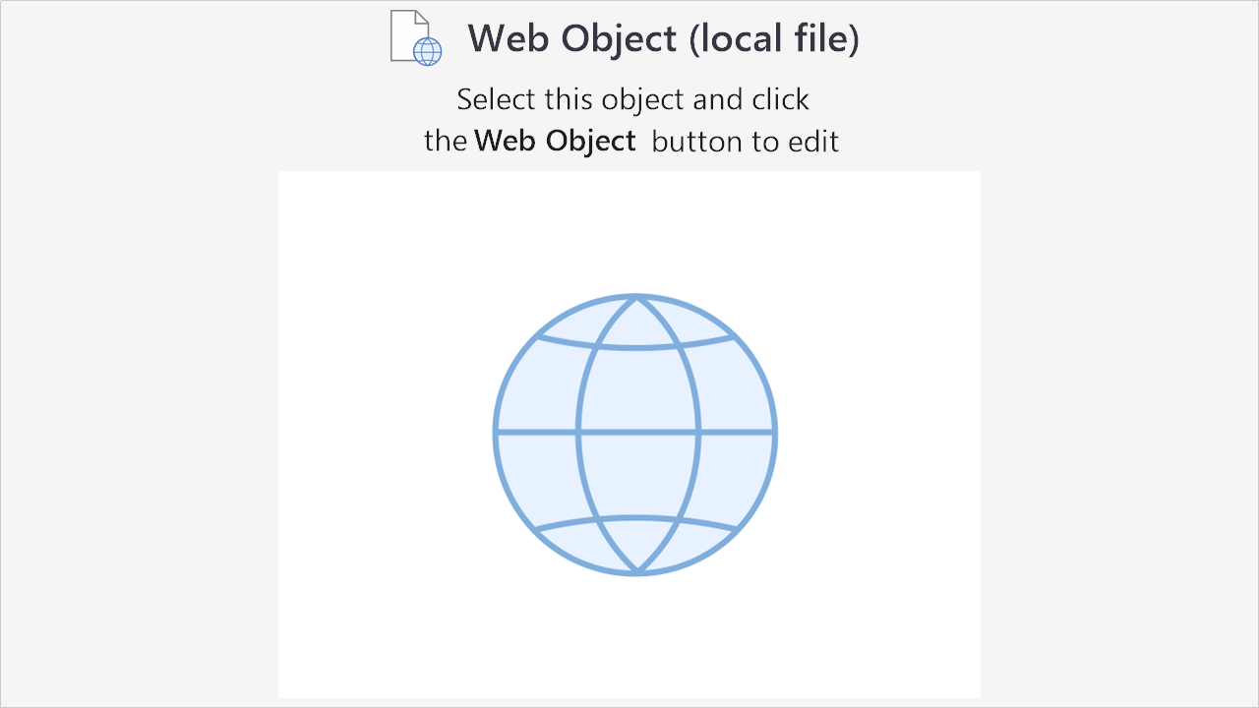
Age of the universe activity.
Notes:
1

